Slide 1
OS PROJECT
-Adarsh A(4NI19CS006)
-Anup Siddu R S(4NI19CS024)

Slide 2
1. PAGE REPLACEMENT ALGORITHM - FIFO (First In, First Out)
FIFO - This is the simplest page replacement algorithm. In this algorithm, the operating system keeps track of all pages in the memory in a queue, the oldest page is in the front of the queue. When a page needs to be replaced page in the front of the queue is selected for removal.
Advantages –
It is simple and easy to understand & implement.
Disadvantages –
The process effectiveness is low.
When we increase the number of frames while using FIFO, we are giving more memory to processes. So, page fault should decrease, but here the page faults are increasing. This problem is called as Belady’s Anomaly.

Slide 3
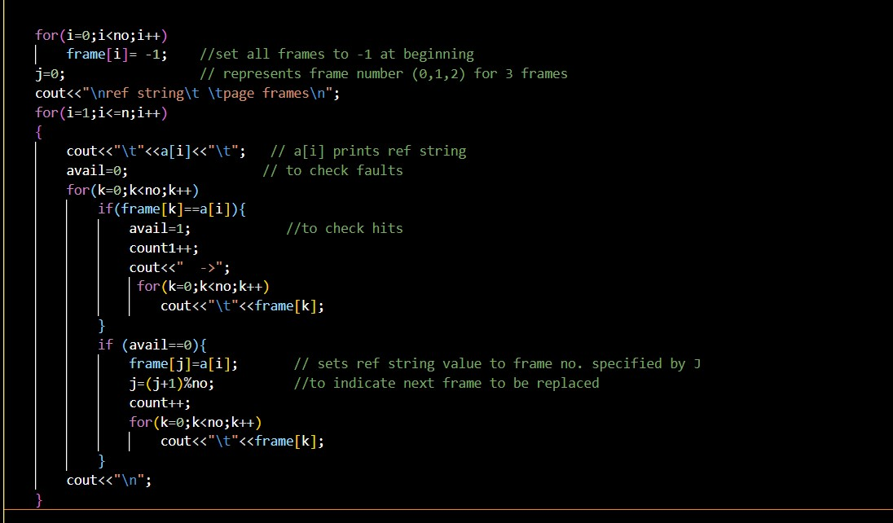
Algorithm – FIFO

Slide 4
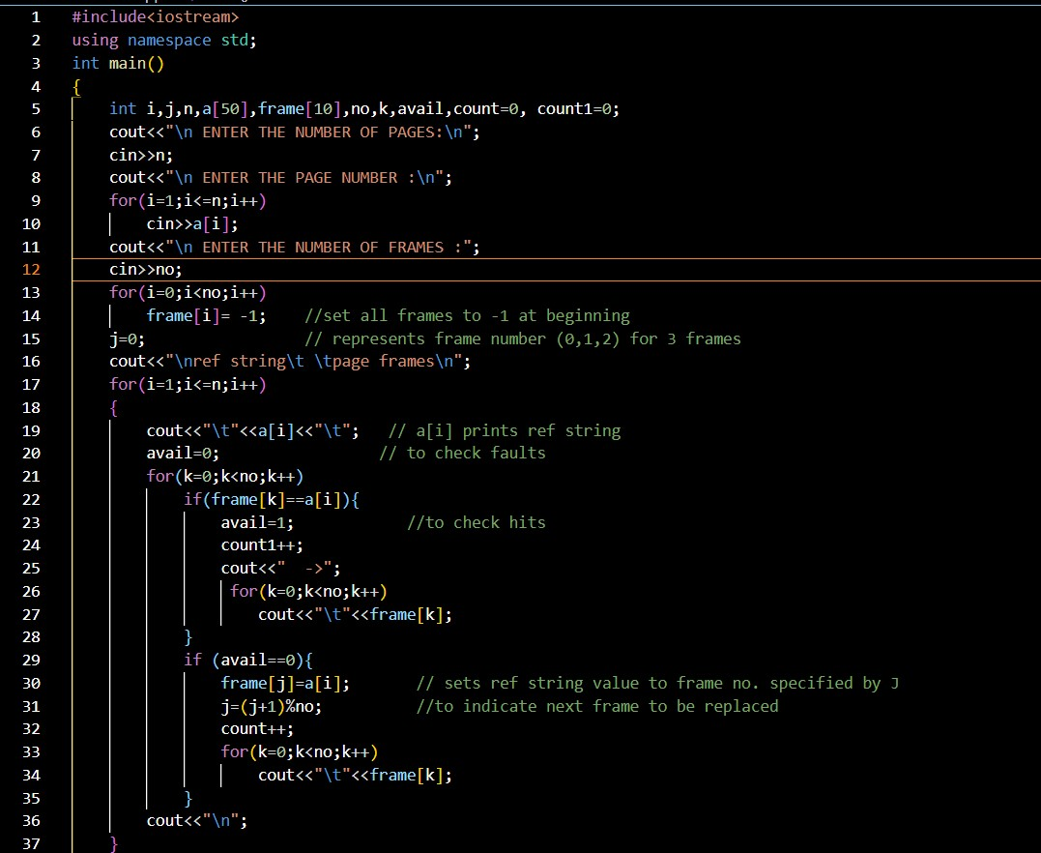
Program -

Slide 5
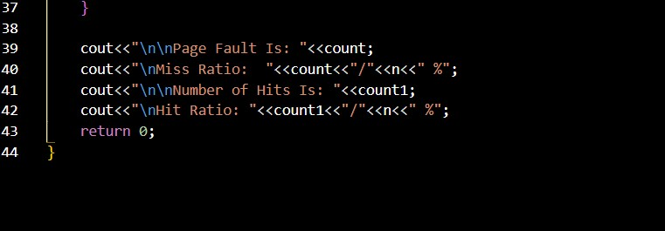

Slide 6
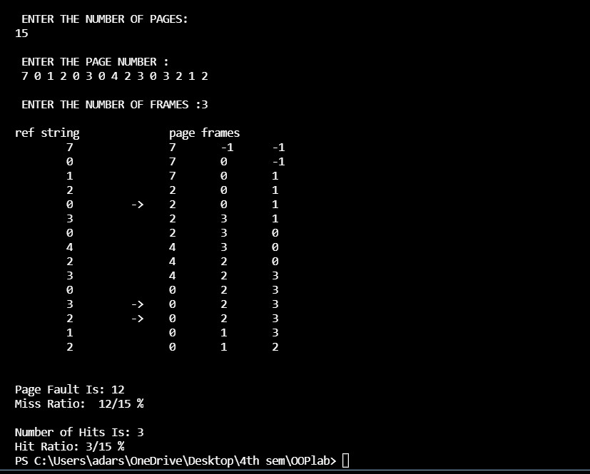
Output –

Slide 7
2. SCHEDULING ALGORITHM – SJF (Shortest Job First)
Shortest job first (SJF) or shortest job next, is a scheduling policy that selects the waiting process with the smallest execution time to execute next. SJF is a non-preemptive algorithm.
Advantages -
Shortest Job first has the advantage of having a minimum average waiting time among all scheduling algorithms.
It is a Greedy Algorithm.
Disadvantages-
It cannot be implemented practically since burst time of the process cannot be known in advance.
It leads to starvation for processes with larger burst time.
Priorities cannot be set for the processes.
Processes with larger burst time have poor response time.

Slide 8
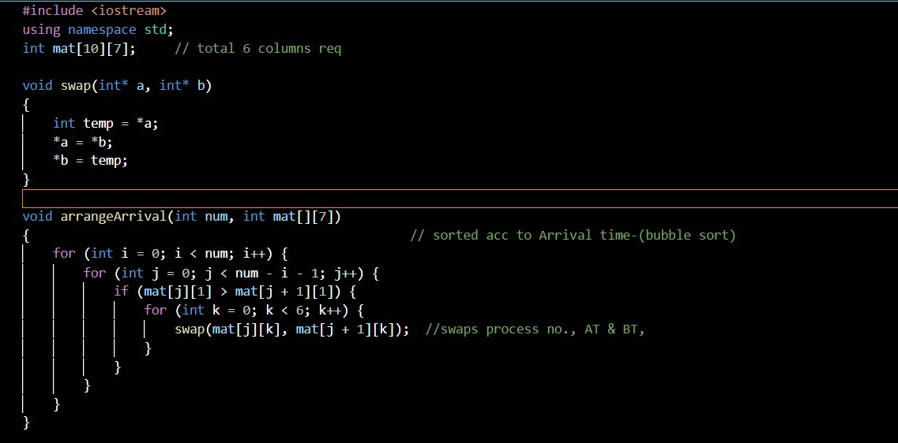
Algorithm- SJF

Slide 9
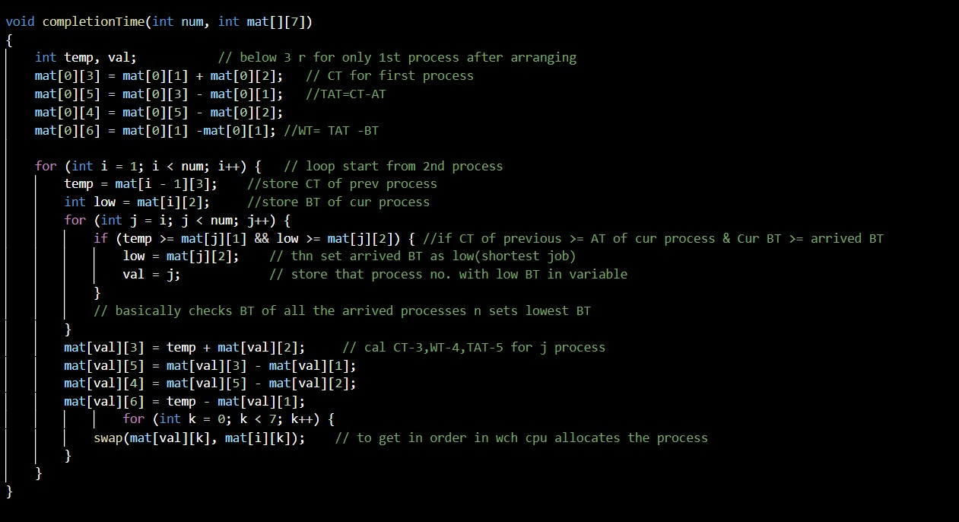

Slide 10
Program –

Slide 12
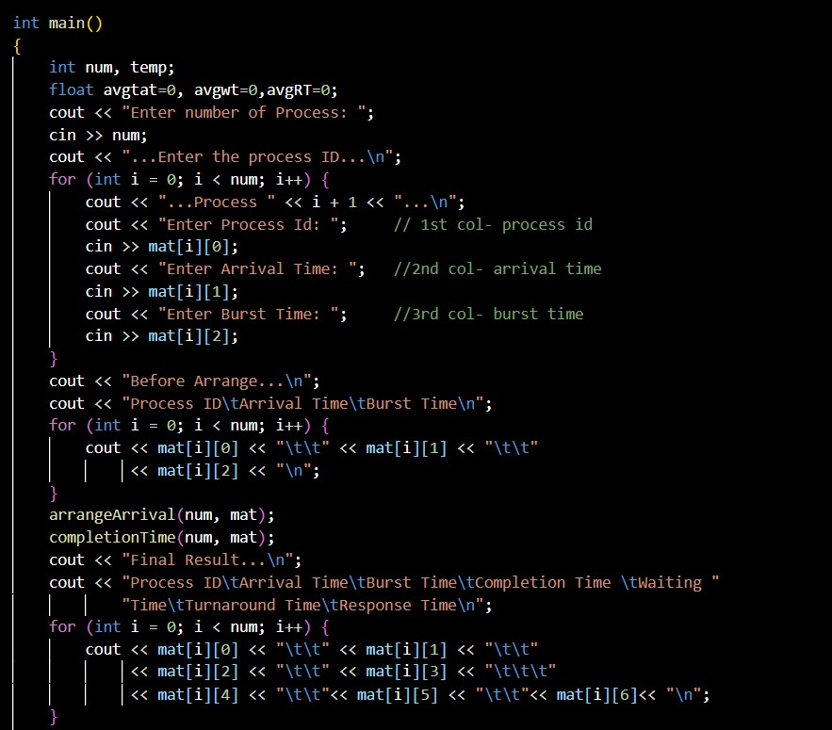

Slide 13
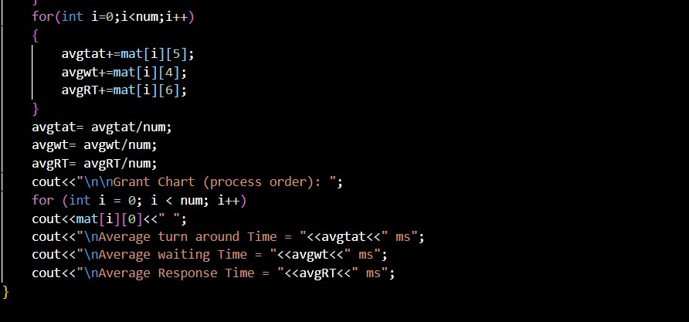

Slide 14
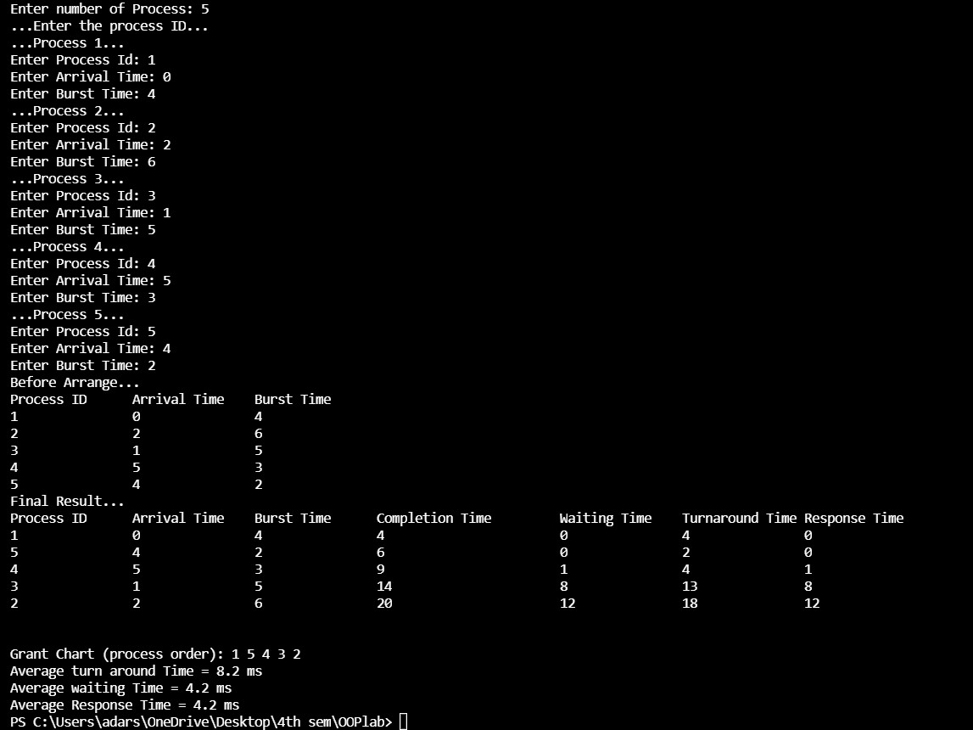
Output -

